Slide 1

Vincent’s last 6 months
Your weekly dose of ”huh, interesting”
Special– for NBIO 207A, data analysis
Check speaker notes for comments and feedback from in-person discussions
Vincent’s light commentary on slides
Notes:
For don- Monday after the break– give him a presentation wherein I make the case that we see interesting and reliable intra-state dynamcis

Slide 2
What type of input am I interested in?
Any ideas to do with how to test hypotheses I’ll present soon
Holes in my analysis
Holes in my theory
Quantifying the existence of the dynamics I’ve identified (as vibes-based science don’t cut it)
Other notes (eg. anything)

Slide 3
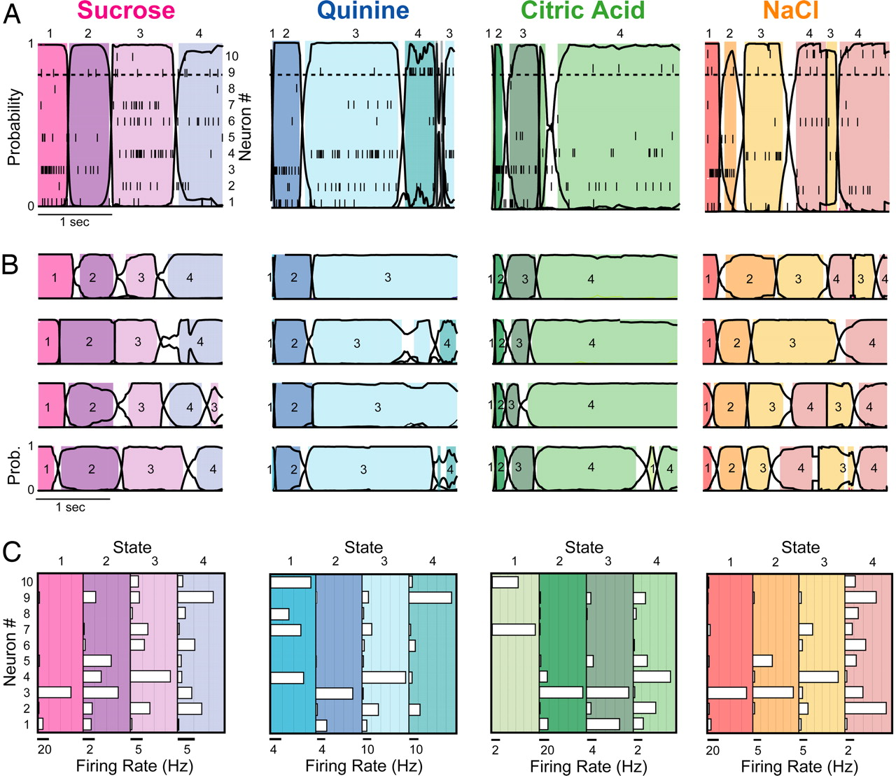
Intra-state dynamics: A brief overview
A constant emission HMM would assume:
Constant emission attractor states
Which would indicate intra-state spike trains are largely flat
This is likely simplistic
Intuitively, consider: neural processing needs to be happening somewhere
A
B
C
D
Spike trains do not appear to contain constant firing rates
A) Coherent state sequence in representative GC ensemble response to sucrose during a single trial (Jones et al 2007). Neuron spike trains plotted within spikes. Non-constant spike trains circled in red and shown in B, C, and D. Changepoints inferred via constant-emission Hidden Markov Model. Epochs 1, 2, 3, and 4 are referred to as detection, identification, palatability, and decision states respectively (via various Katz lab papers).

Slide 4
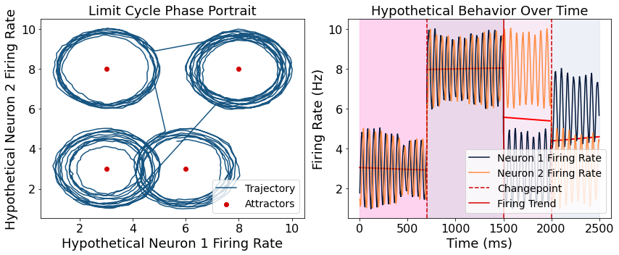
What type of dynamics? (theory)
We believe we’re looking at a non-linear system, which we have evidence for (will be shown).
Specifically, we hypothesize the network we’re working with non-linear attractors (see example of limit cycle below)
Probably NOT a limit cycle

Slide 5
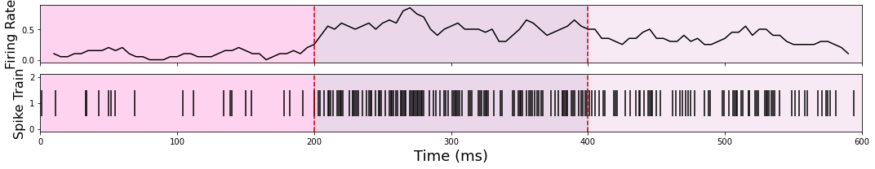
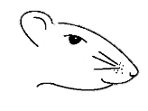
Brief slide on methods
Suc
NaCl
CA
Quin
Inferring firing rate from spike train– rolling window (very basic; 250 ms window with 25 ms step)
Dimensionality reduction:
PCA– only really useful for linearly correlated data (?)
Autoencoder RNN (block diagram below)– able to capture non-linear dynamics
Data acquisition: Sucrose [0.3M], NaCl [0.1M], Citric Acid [0.1M], and Quinine [1 mM] were delivered directly onto the tongue of female long-evans rats in a pseudo-random order using an intra-oral cannula. Extracellular recordings were taken from GC while tastes were delivered.
Original Input Data
Low-Dimensional (8 dims) RNN
Encoding Step
Reconstructed Data (should be identical to input)
Decoding Step

Slide 6
What am I currently able to argue to you?
What I am arguing: that interesting, non-linear dynamics exist in GC between epochs
I have demonstrated this on a single-neuron basis
Working on doing so on a population basis
(input here would be great)
What I may be able to make a claim about: The *general* characteristics of these dynamics, including some theories as to what’s what
What I am not yet to the point of making a claim about: Specific classification

Slide 7
The question I’m trying to answer right now
I’m focused on proving non-random and state-specific dynamics. I have basic descriptive stats for single-neuron. Doing the same for the multi-variate states I’ve shown you can be done (eg. multi-variate t-test); rigorously proving this is more involved
This is what I’m stuck on
The latter part attempting to test rigorously that the pattern of activity in one state is different from other states.
- Handling noise (proving these dynamics are not noise) is also part of this
First, some background:

Slide 8
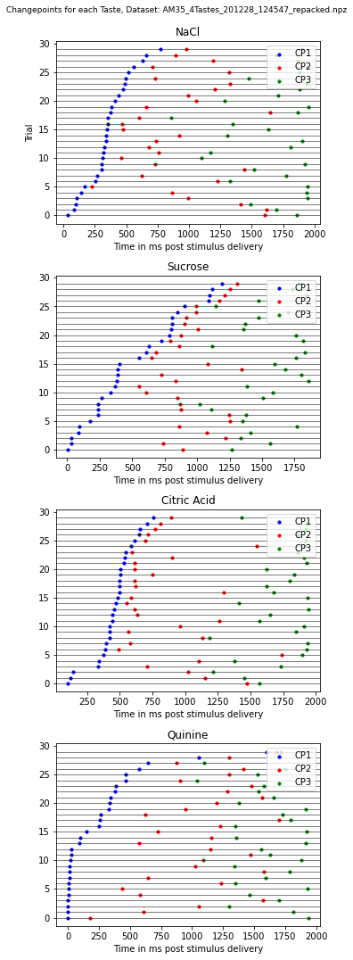
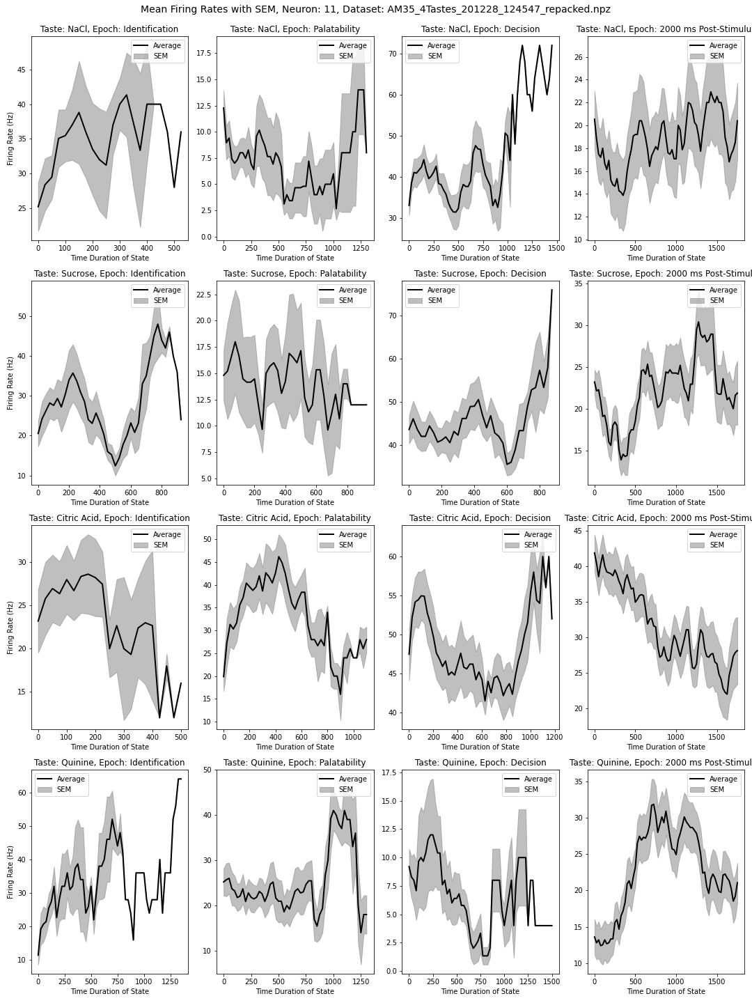
Starting with 1 neuron across trials-- What’s the deal with SEM duration?
Left: Mean firing rate across all trials for a single neuron; standard error of mean mapped around
Uninterpolated data
Right: timing of state transitions across all 30 trials for this one neuron. This variation is a feature, not a bug.
Hypotheses:
Nonlinear dynamics present (multiple different types, so it seems)
State durations are important – Positing that these reveal the time it takes the population to reach completion in processing
Mean firing rate and standard error of mean across trials for one neuron (30 trials)

Slide 9
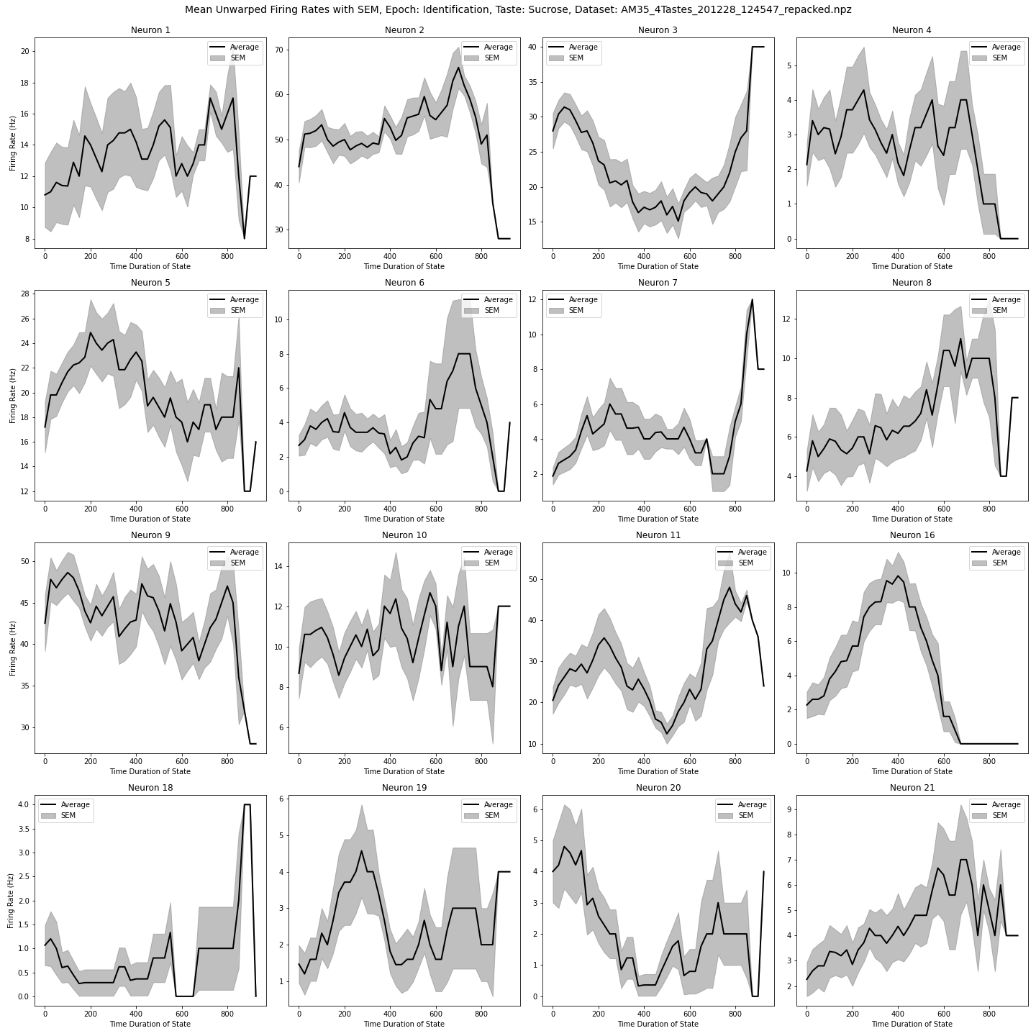
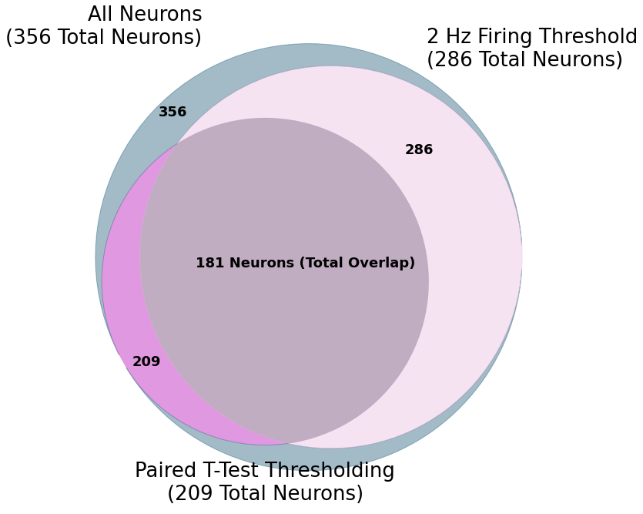
Many Single-neuron evidence for dynamics (one taste)
Large amounts of data: Thresholding via paired t-test (alpha = 0.05) and 2 Hz minimum frequency reveal sustained and dynamic intra-epoch firing is present in a large subset of the neurons across all datasets (n = 17). Thresholding allows us to filter down to neurons with firing rates more amenable to observation of dynamics.
Representative sample of single-neuron trial-averaged firing rate over time for a single stimulus and single epoch (sucrose, identification). Standard error of the mean plotted in grey around trial-average line. Distinct neuron-to-neuron differences in dynamics seemingly appear, suggesting multiple attractor paradigms may be present within a given epoch for a given population.

Slide 10
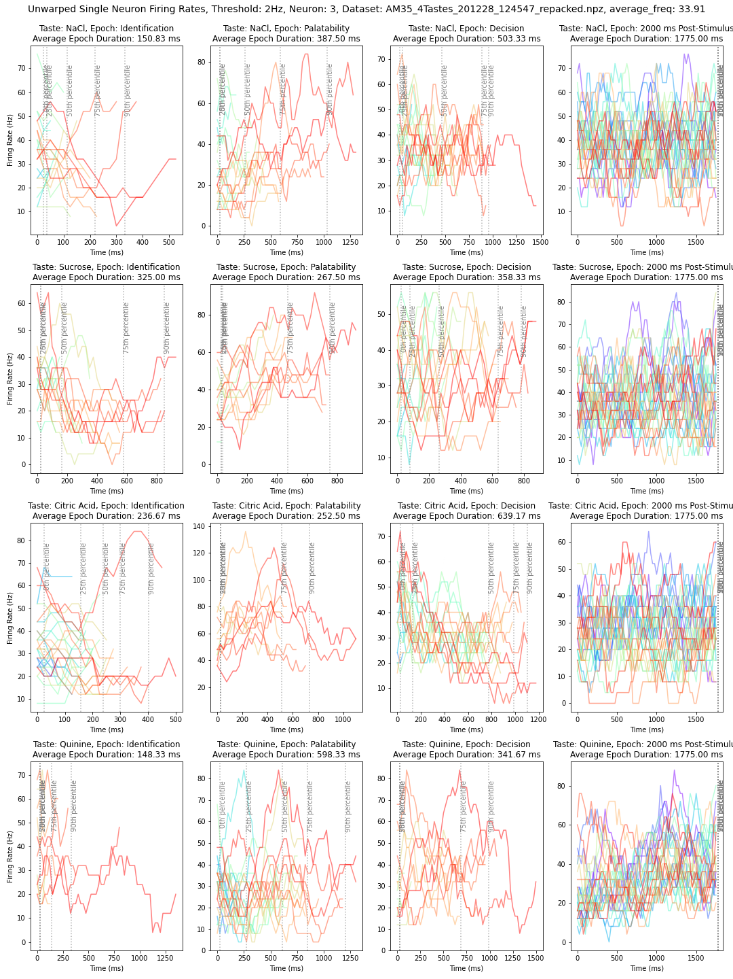
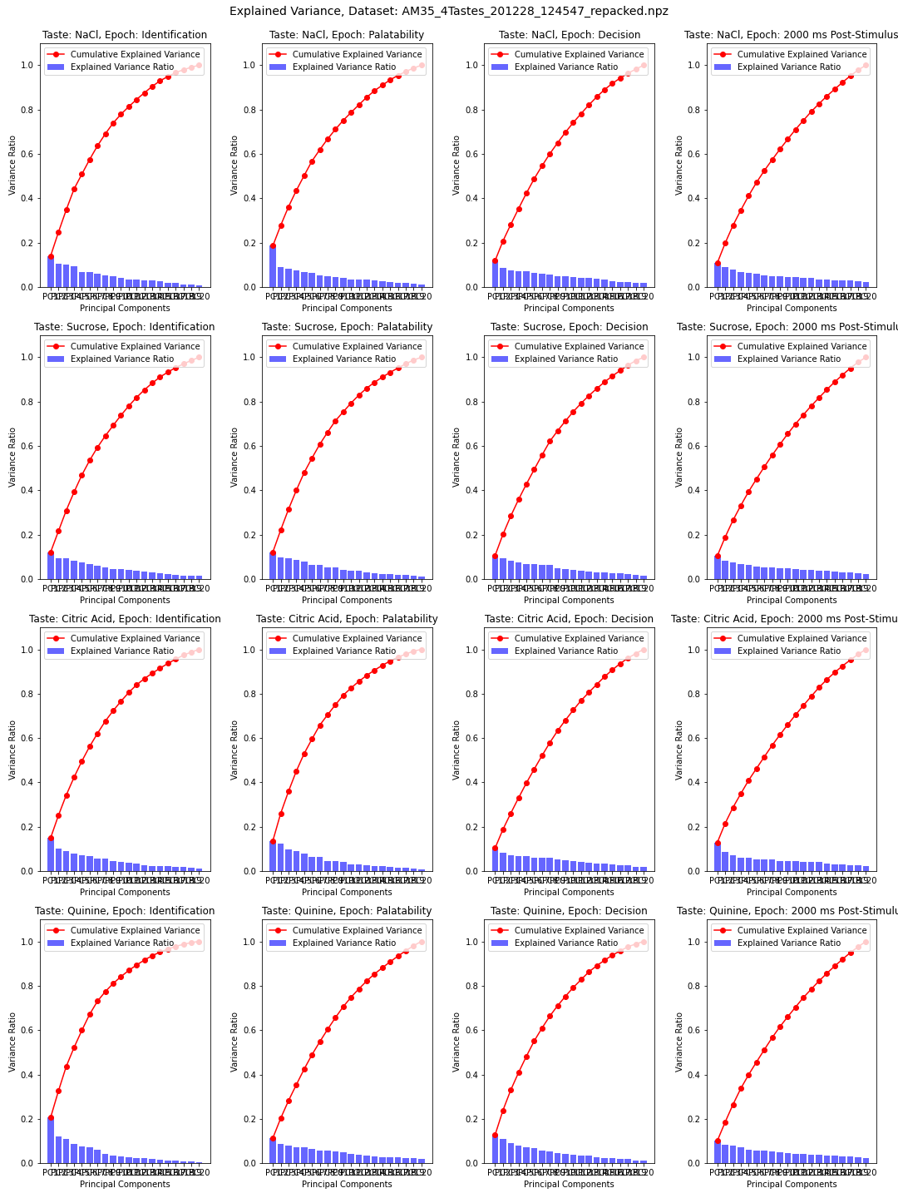
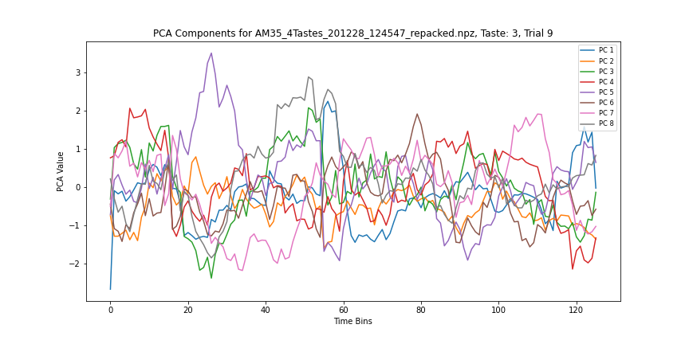
Reducing dimensions: noisy data, nonlinear data
Left: example of a single neuron’s firing rate, across all trials, across epochs (cols) and tastes (rows); you can see how noisy it is
Bottom: attempt at expressing population behavior via PCA for one taste and one trial. They all look like this.
Right: The real issue with using PCA on this data: poor correlation.

Slide 11
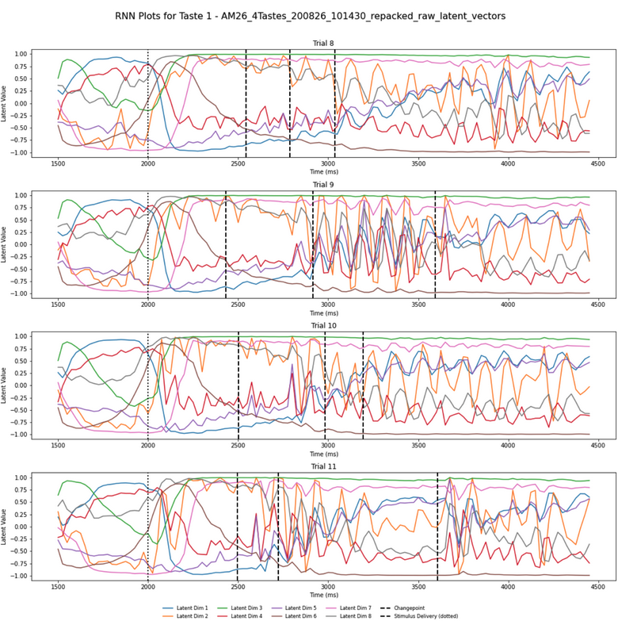
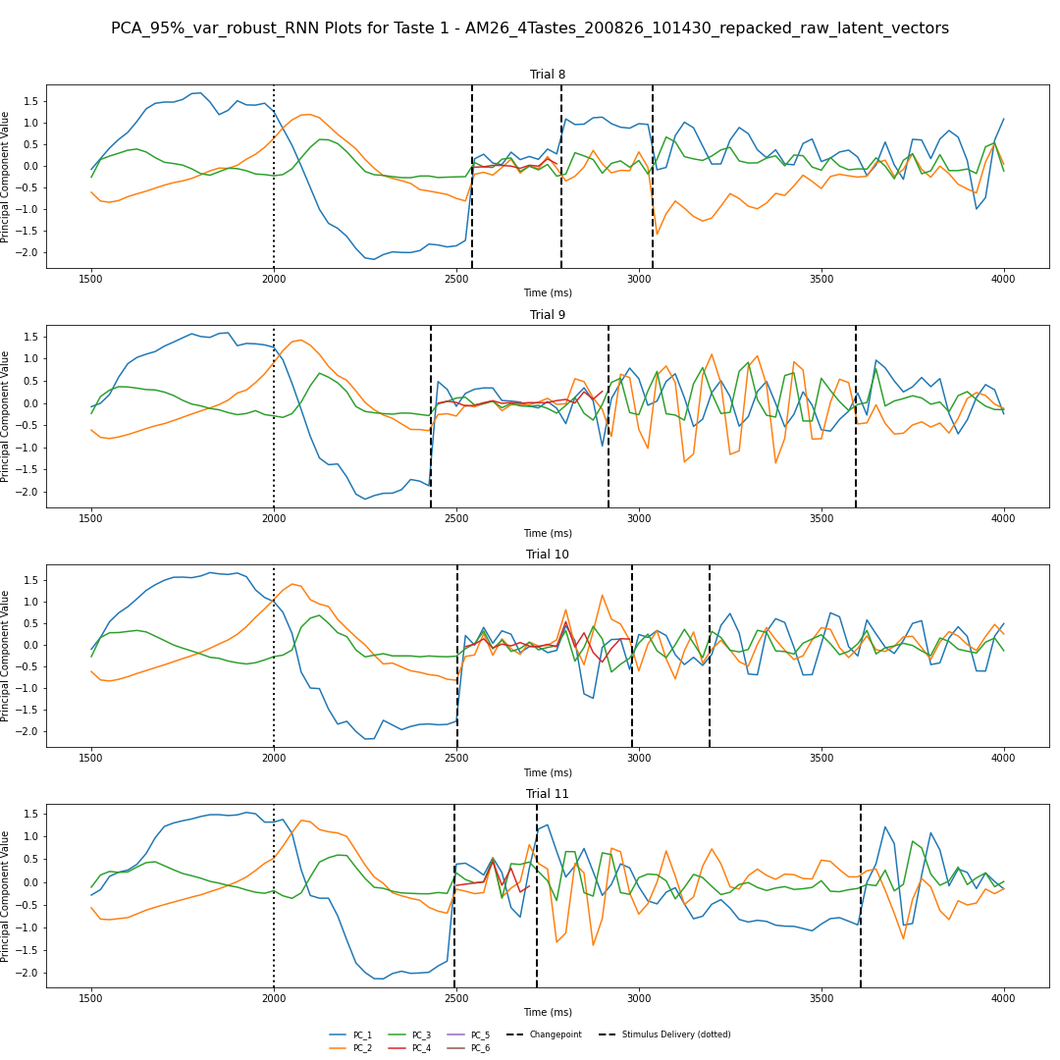
So let’s do non-linear dimensionality reduction
Example of reduced dimensions for 4 trials of one taste; 8 latent dims inferred
RNN trained on the whole dataset; taste-by-taste (and trial by trial) basis – Considers all neurons
Seem to be getting somewhere
Note the appearance of oscillatory dynamics (I’ve checked; this is not a fluke or an artifact so far as I can tell)
RNN Inference
PCA (>95% var) on RNN inference data

Slide 12
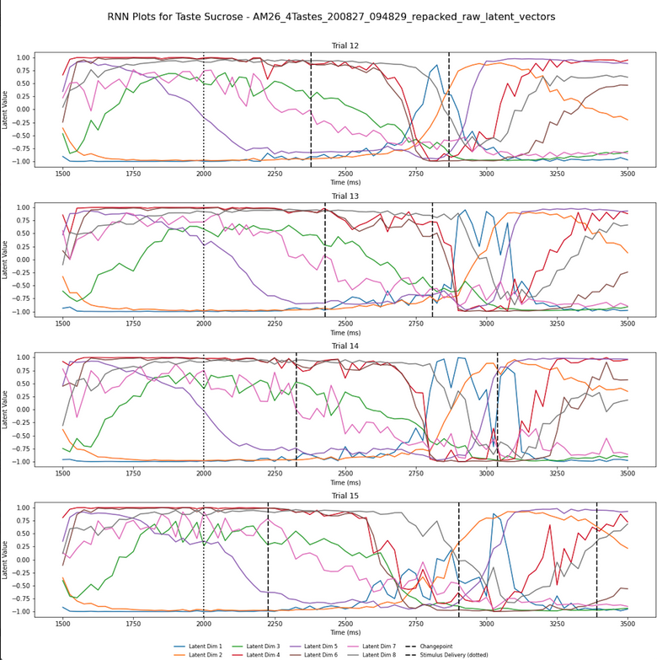
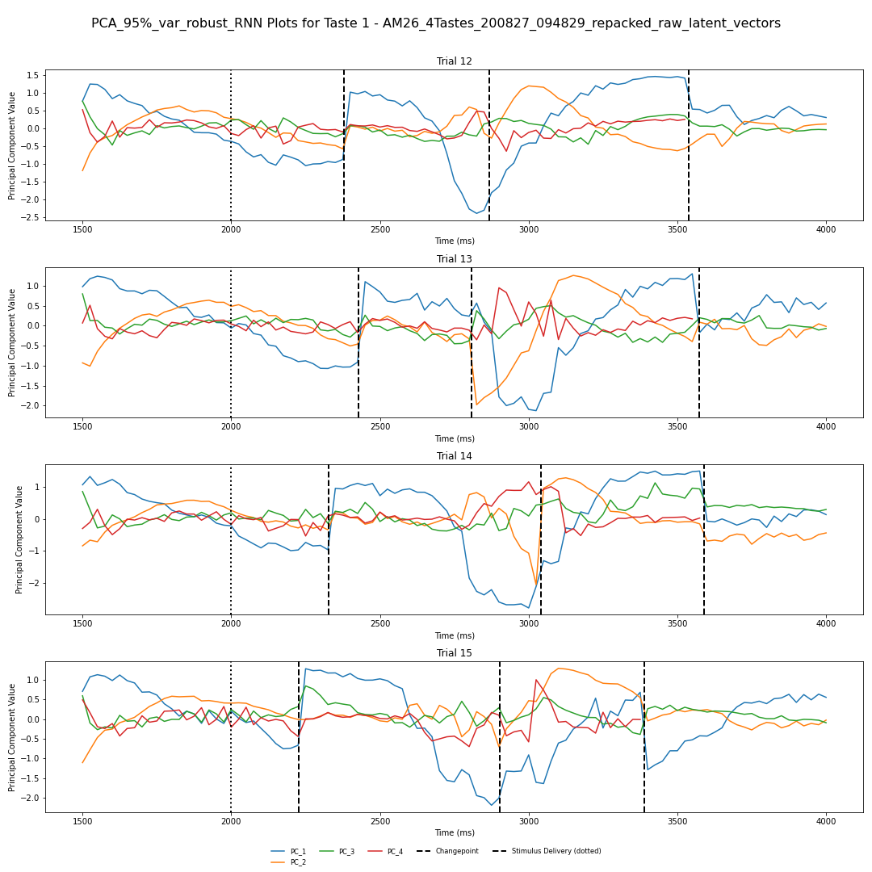
What we’ve seen: Analysis on RNN data – Right is RNN output Left is PCA on a trial-by-trial basis of the RNN data
Another example of this– note especially the sharp change in latent dynamics right at inferred changepoints, which is expected
Notes:
Also do the RNN PCA transition aligned – both raw latents and PCA latents– chop em up
Take a window around the transition (top of list)
2 methods:
what’s happening within a state
What’s happening around a transition (250 MS before and after) -- RNN and PCA of RNN latent -- windows around the transition to see how well latents align with transitions
Following this what the latents are doing within each state
Epoch-aligned: start to end of the epoch
Be careful of doing PCA on every single trial– not guaranteed to get that on every single trial because there could be drift trial to trial – start w/single PCA across trials (concat all trials then do PCA – stack along time; do PCA on this)- this should give what we want assuming there ISN’T drift across latents – once PCA is run do a transformation back into trials and plot the way we’ve done so (~95% var, if a lot then keep the top 5 and record how much variance each of those components explain) – I want to explain the cumulative variance from the latents and from the raw firing rates

Slide 13
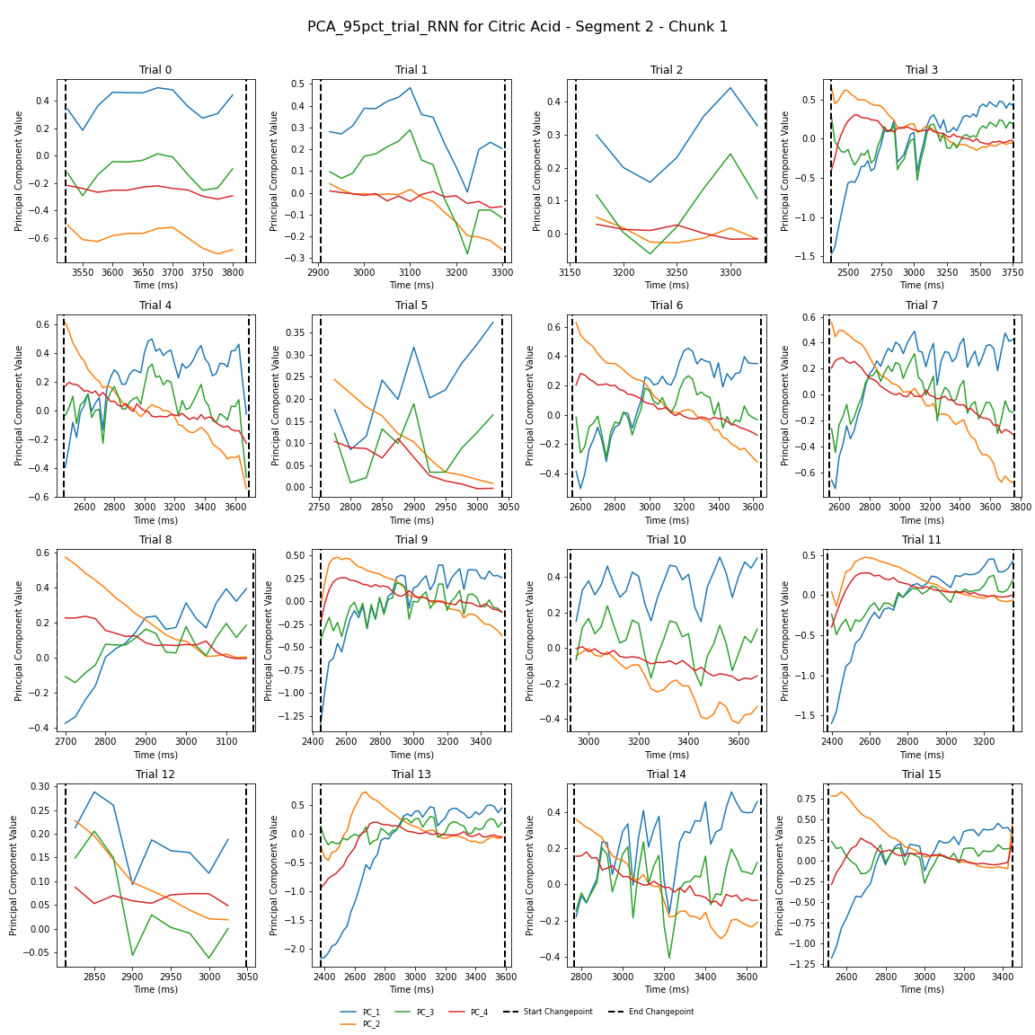
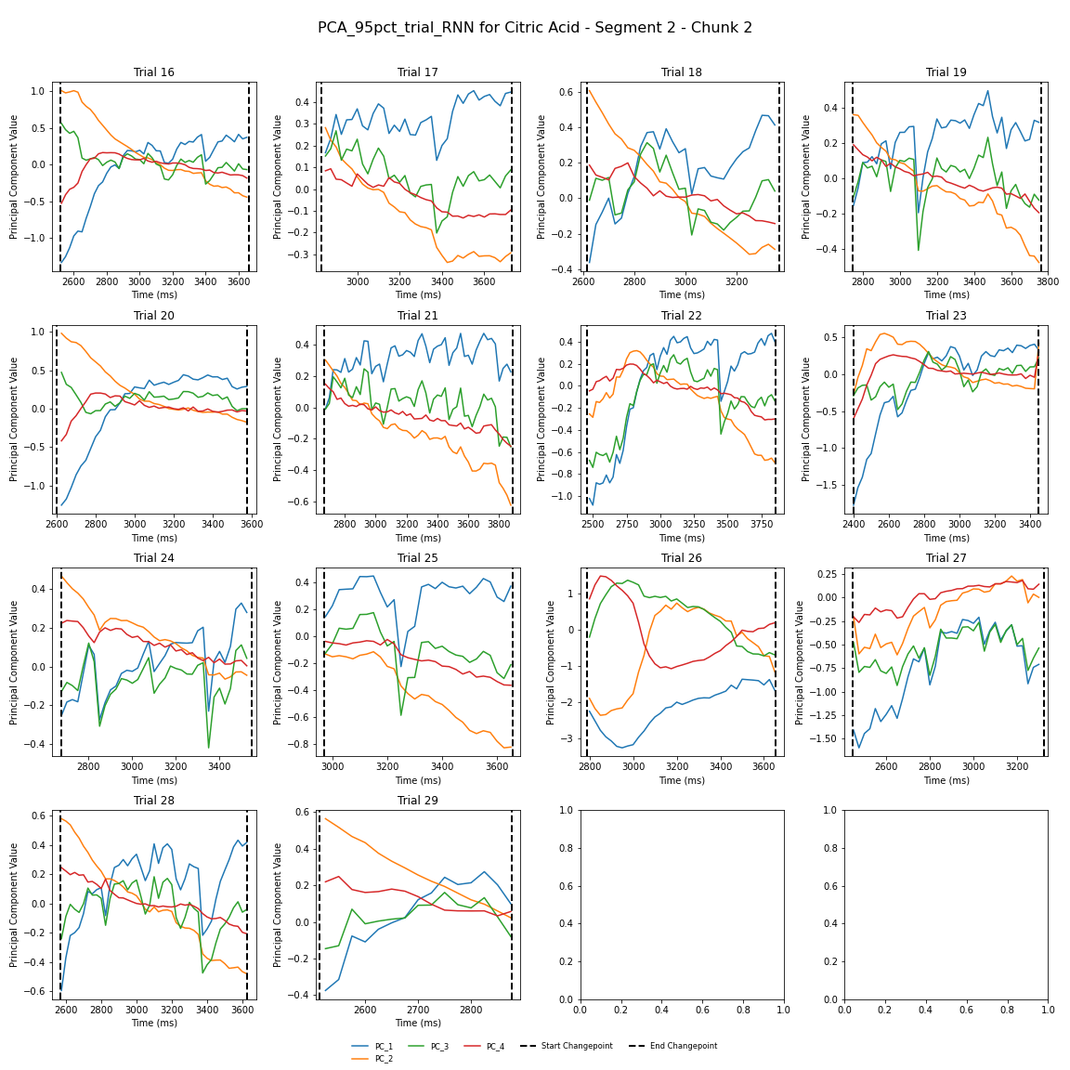
NOTE: X-AXIS TIME FRAMES ARE NOT CONSTANT. All trials of one taste, as fed through these steps. Same data as before (200827)–
Looking for: what are the dynamics doing? Do they seem to be stretching or shrinking appreciably?
To don’s hunch: It seems like there are more than a few trials that exhibit largely (ish) the same behavior-- see boxed trials, color coded.
Note: Timeframes vary wildly– from 300 ms (trial 12) to 1200+ ms (trial 3). Todo: figure out how to better identify these similarities
Notes:
We need to figure out a better way to cluster these– once we have the figure of latents across transitions across all trials (see previous, which will show that there are transition-aligned dynamics), we can then ask how we can cluster what we see here. Perhaps cluster/sort along a couple vars– Plot all trials for the latent, perhaps sort by length – try the interpolated/uninterpolated stuff agai; Under *some* assumptions we could just cluster these-– but there are questions:
- Are we trying to cluster at the single latent level, multilatent? Deal with differing lengths and from there it can be pretty straightforward. Similar to clustering whole trials (which has the bonus of that they’re all the same len)
We still very much want to do interpolated/uninterpolated side by side; if we need to do expediency we may just do one or the other– but we should not pre-suppose that doing one vs the other is the better way to do it.
Note to Vincent: You made a real mistake forgetting to put the dataset name in the title of the figures this time round bud…that’s gonna come back to haunt you; you should fix that shit– otherwise you’ll never be able to find what figure was interesting.

Slide 14
Questions I’m trying to answer:
I’m focused on proving non-random and state-specific dynamics. I have basic descriptive stats for single-neuron. Doing the same for the multi-variate states I’ve shown you can be done (eg. multi-variate t-test); rigorously proving this is more involved
This is what I’m stuck on
The latter part attempting to test rigorously that the pattern of activity in one state is different from other states.
This get into the idea of analogous pairs: can I identify and quantify repeated characteristics?
Dealing with these different state durations
Handling noise (proving these dynamics are not noise):
My idea is: if we assert what we’re seeing is not noise on top of a flat level, the mean of that noise should be zero. When taking the first diff of the data, if the mean of that is NOT zero, that would go to show mean we’re looking at more than random. Eg. oscillatory states would be especially obvious

Slide 15
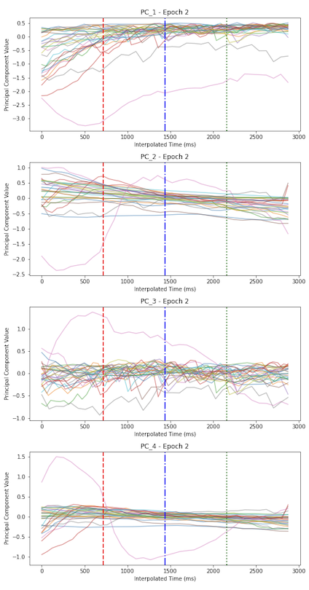
Interpolating all these trials: womp womp
The hypothesis with interpolation would have been that dynamics are effectively “grouped”
My working theory as to why this is such a poor result: PC 1 for trial 1 is not the same as PC 1 for trial 5 (as an example) – as each trial is similar, but as we’ve seen, clearly not the same

Slide 16
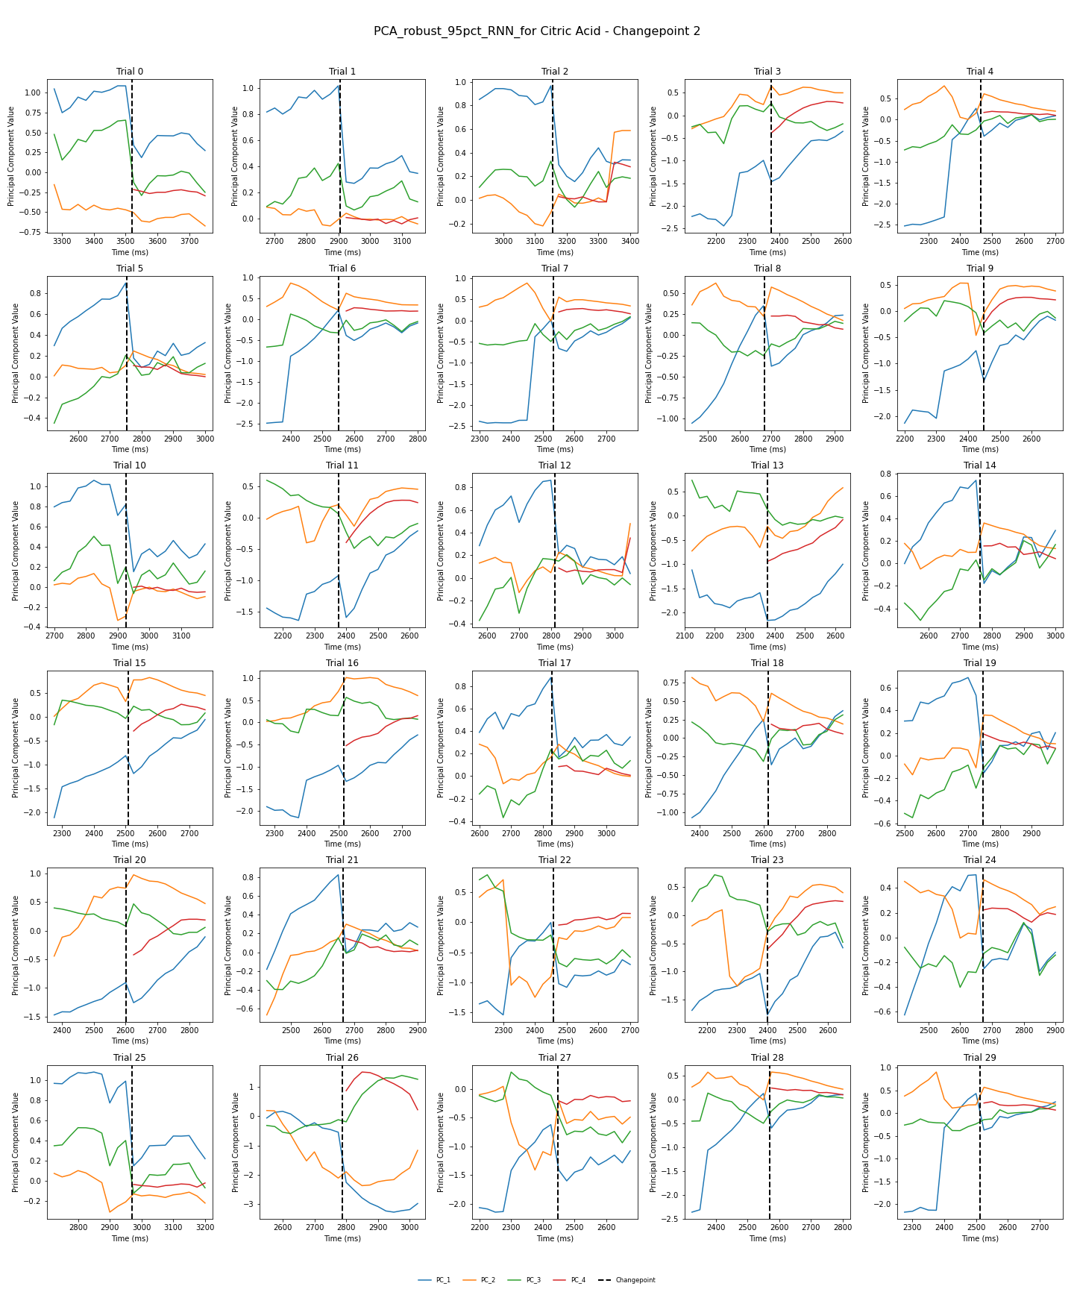
Looking at behavior before and after CP Data: PCA on RNN across trials rather than trial by trial Citric acid, CP 2 Thresh. Vectors To 95% of explained variance (dataset 200827..)
Evidence of a regime change
Note; we see the addition of the red latent after the changepoint in every single trial for this particular animal.
Looking for:
consistently sharp changes in latent behavior around the changepoint
Any potentially conserved dynamics across trials
Consistently, something interesting is happening
I made an attempt to color-code certain trials by pre-transition dynamics I thought were similar-looking
There were immediately 3 dominant-ish looking groups that popped out to me
Notes:
Abu want a fig where a single subplot is one latent vector across ALL trials for one transition– 8x3 subplots (8 vectors, 3 transitions)

Slide 17
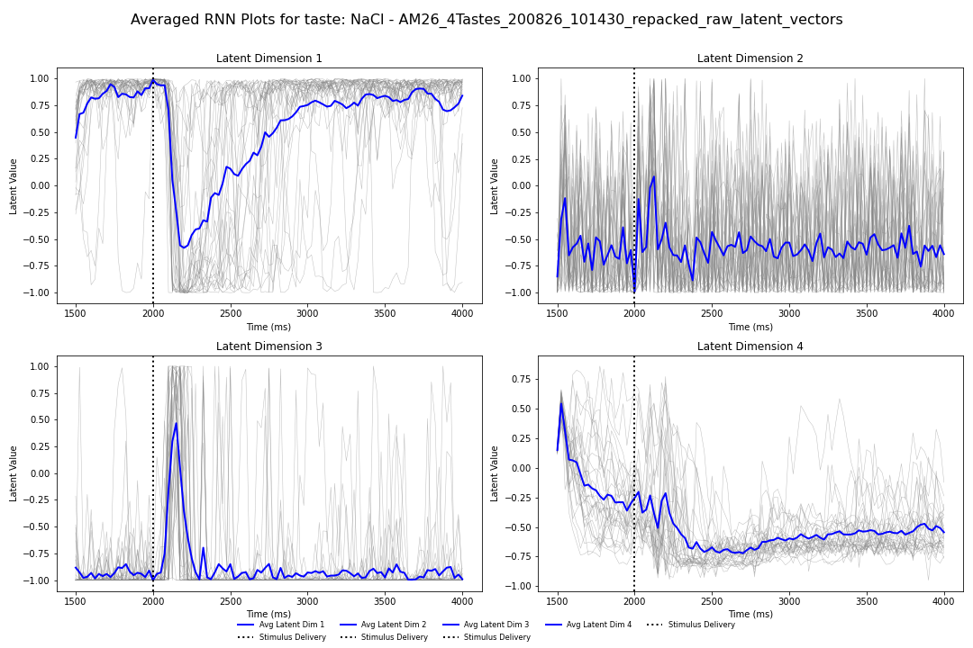
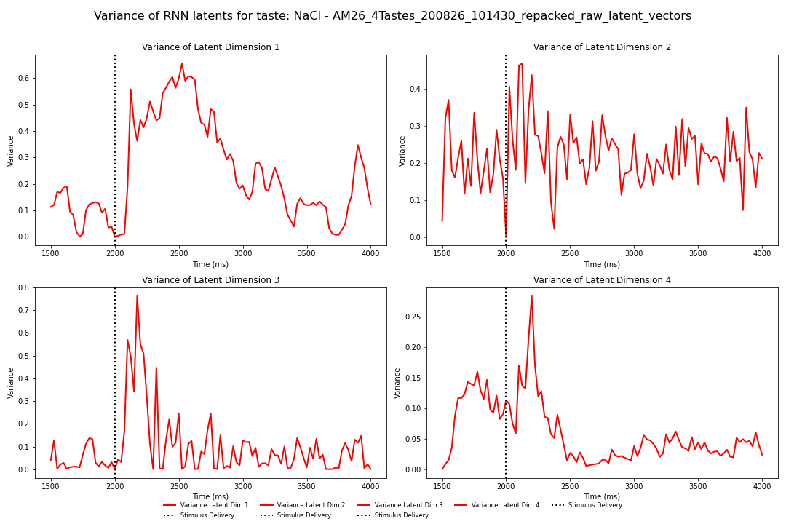
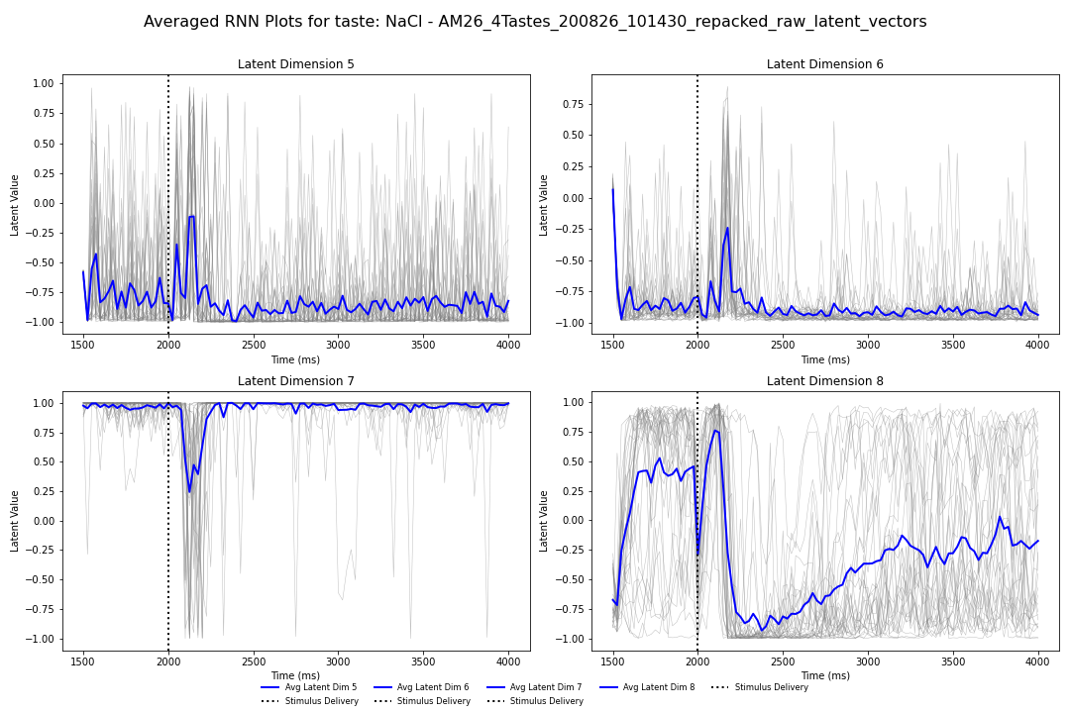
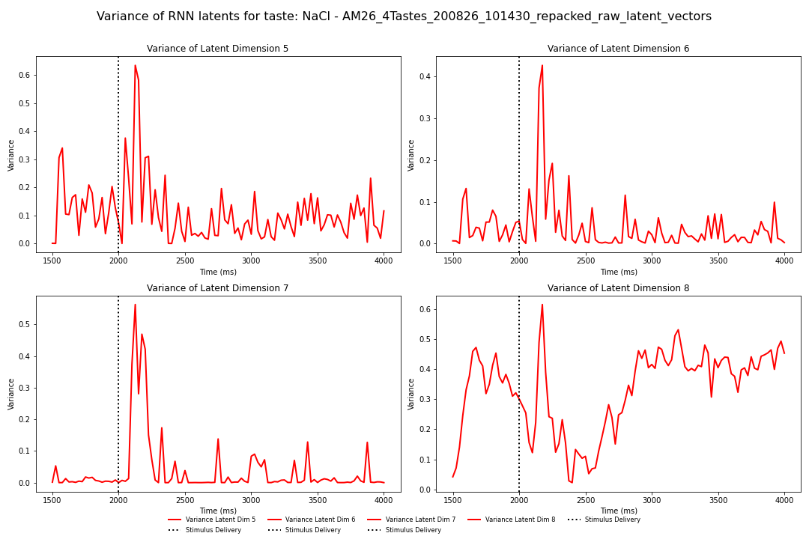
What are RNN latents doing over trials? – NaCl, Left: RNN trajectories, right: Variance of trials over time
What we see here:
Left is RNN trajectories over time with average
Right is variance of trajectories over time (NaCl)
Note: we see a very large spike in variance of trajectories immediately after stimulus delivery, after which the story gets… a bit more complex
Interpretation is not yet clear to me
Considering doing some wave decomposition or something
Notes:
This is honestly probably the figure that we would show BEFORE anything to do with the PCA inferred stuff; we can talk about single-trial lines and etc. There’s AN average structure and there’s trial-to-trial variability, moving on
Look into it more but this is back-burner compared to transition snippets and epoch snippets of the latents
Rather than plotting the latents and the average of the latents– let’s plot the variability of the latents over time – and if we get the variance measure and we start to see commonalties, then we start to see commonalities in the latents

Slide 18
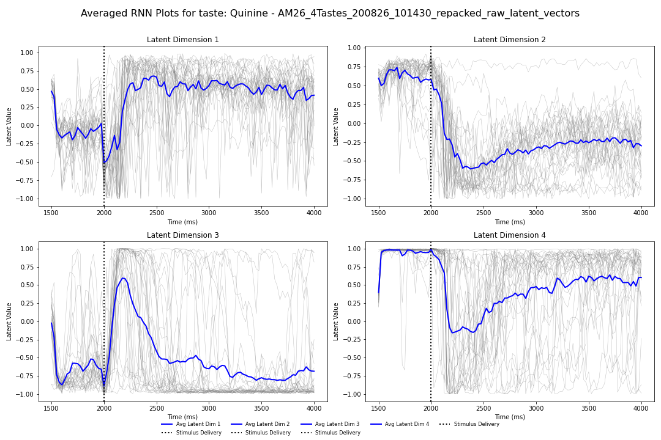
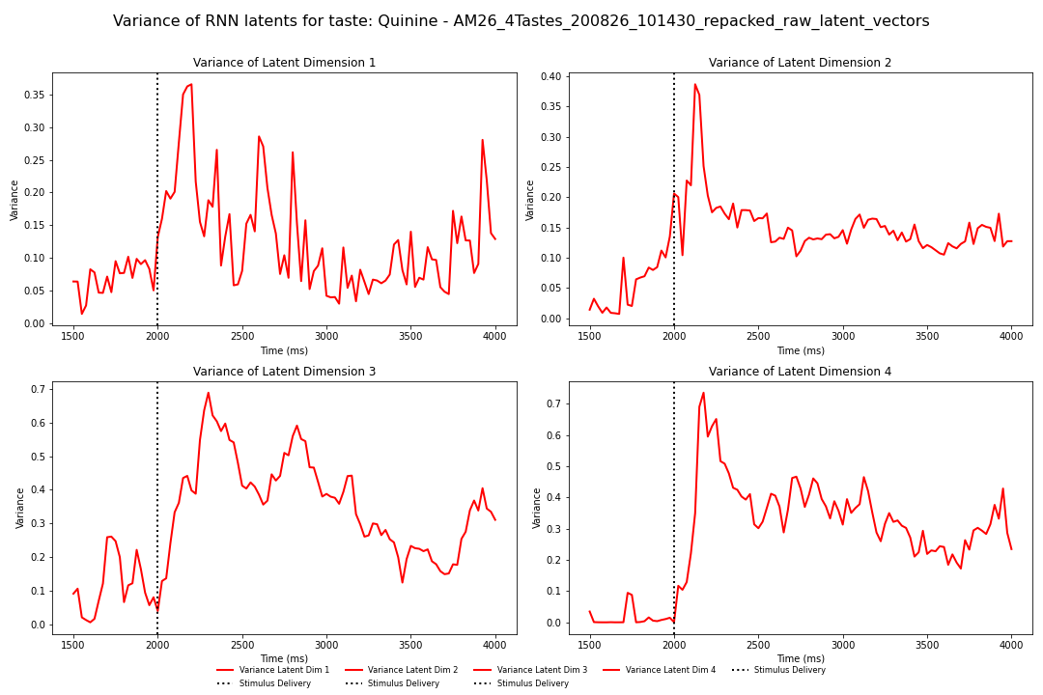
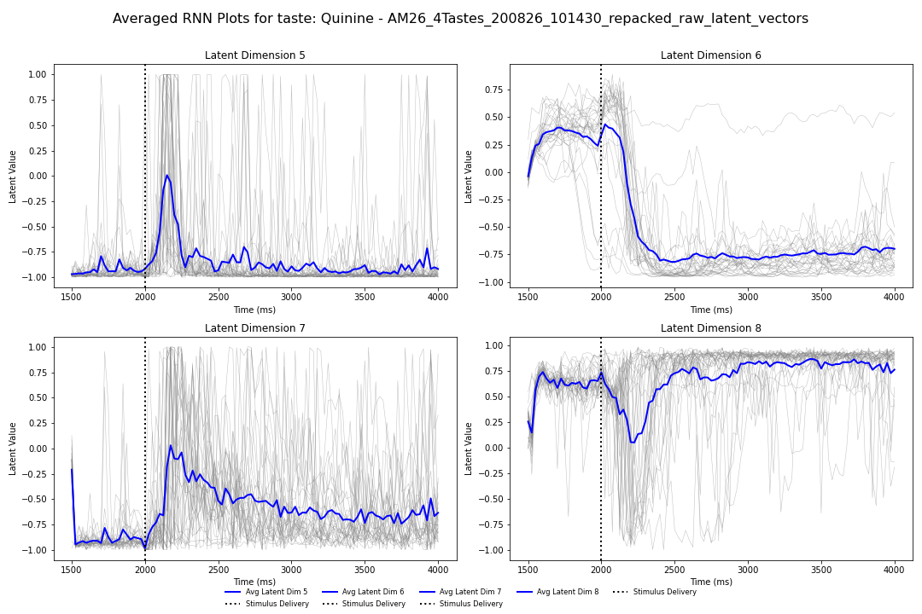
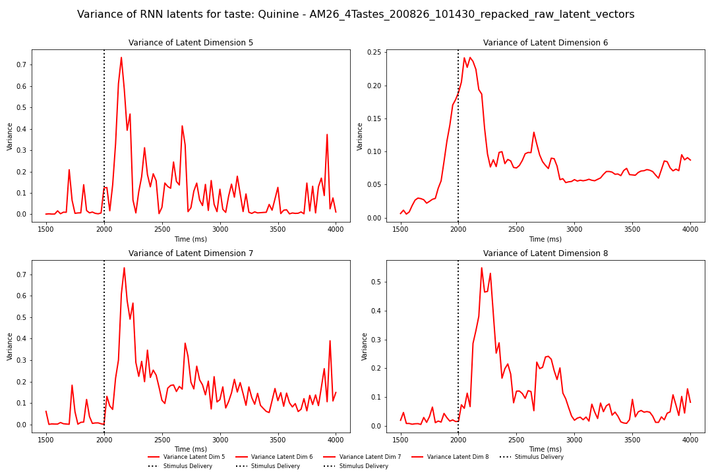
What are RNN latents doing over trials? –Quinine, same type of analysis as previous slide
What we see here:
Left is RNN trajectories over time with average
Right is variance of trajectories over time (quinine)
Note: we reliably see a large spike in variance of trajectories immediately after stimulus delivery, after which the story gets… a bit more complex (but generally trends down)?
There’s real variability in how the variance trends depending on the data
Interpretation is not yet clear to me

Slide 19
1.21.25: ideas and to do
TODO:
Analysis on interpolated state data from trials to see what latent vectors look like (stretching RNN states to the same length)
Investigations of pre-changepoint transitions appear to not be a huge concern
Want to find a more robust way to analyze PCA trajectories-– and grouping similar trajectories
Want to map PCA trajectories like I’ve done on the RNN (slides 7,8)– may help to elucidate RNN data directly
Want to see how % dataset variance changes over time for the PCA on RNN data
Introduction of more/fewer vectors is also interesting (todo!)
Notes:
Don’t bother with number 4 !
Didn’t think 5 through all the way lol

